Slide 1
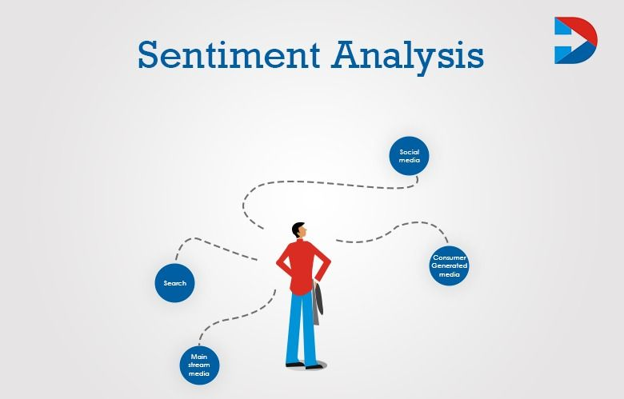

Sentiment analysis
Group member: 1. Shubham yadav 137 B
2. Ujjawal singh 120 B
3. Atul shukla 115 B

Slide 2
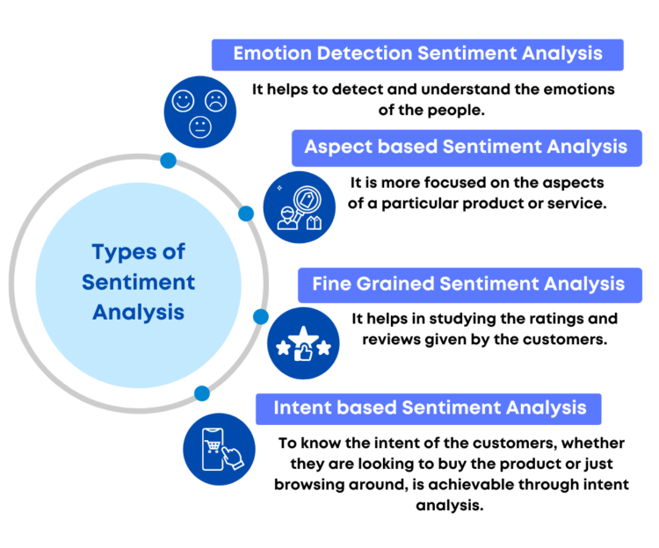
abstract
Sentiment analysis or opinion mining is the computational study of people’s opinions, sentiments, attitudes, and emotions expressed in written language.
It is one of the most active research areas in natural language processing and text mining in recent years. Its popularity is mainly due to two reasons.
First, it has a wide range of applications because opinions are central to almost all human activities and are key influencers of our behaviors.
Whenever we need to make a decision, we want to hear others’ opinions. Second, it presents many challenging research problems, which had never been attempted before the year 2000

Slide 3
introduction
Sentiment analysis (or opinion mining) is a natural language processing (NLP) technique used to determine whether data is positive, negative or neutral.
Sentiment analysis is often performed on textual data to help businesses monitor brand and product sentiment in customer feedback, and understand customer needs.
Sentiment Analysis or Opinion Mining is the computational treatment of opinions, sentiments and subjectivity of text.
In this report, we take a look at the various challenges and applications of Sentiment Analysis. We will discuss in details various approaches to perform a computational treatment of sentiments and opinions. Various supervised or data-driven techniques to SA like Na\"ive Byes, Maximum Entropy, SVM, and Voted Perceptrons will be discussed and their strengths and drawbacks will be touched upon.
We will also see a new dimension of analyzing sentiments by Cognitive Psychology mainly through the work of Janyce Wiebe, where we will see ways to detect subjectivity, perspective in narrative and understanding the discourse structure

Slide 4
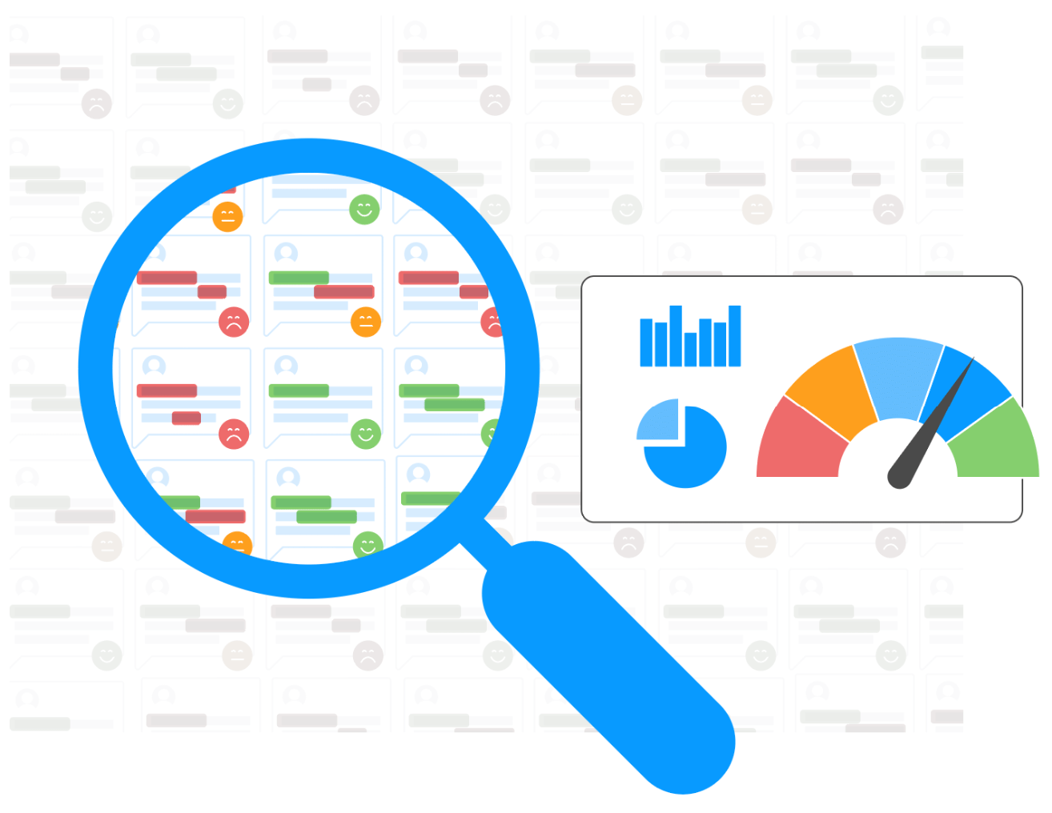
Objective
To be able to tell the impact of an individual.
System should be open source as well as free to use.
Achieve almost better accuracy rates for generation of rating compared to conventional methods.
Enhance data for maximum efficiency using pre-processing.
Archive the output in the least time possible.
Accuracy of our project are 70 %

Slide 5
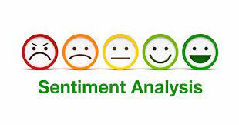
scope
Improved customer service
Establishing a loyal customer base
Proactive crisis management
Monitor your social media
Analyze your product
Monitor your social media

Slide 6
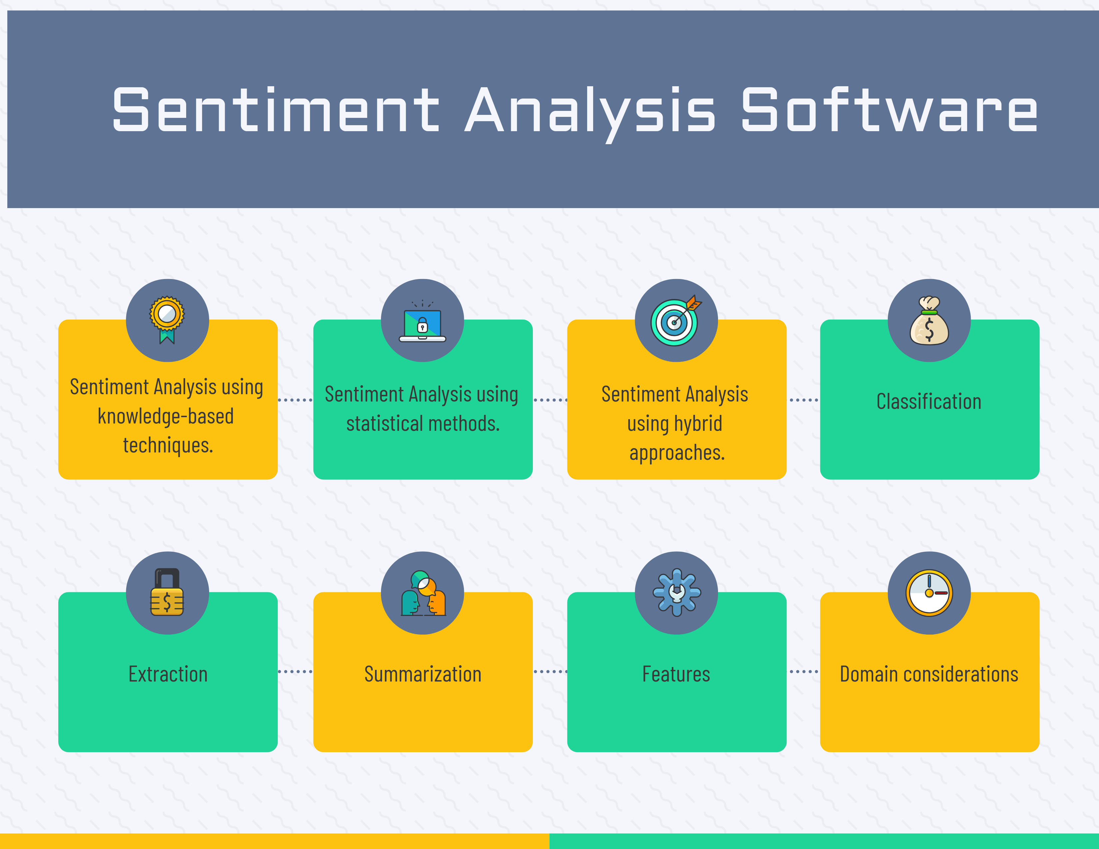
Technology used
Python/Streamlit
AI Model used – pandas , textblob, nltk , numpy , SciPy , Matplotlib .
Python Framework- Streamlit
More than 70,000+ data In our Dataset
Excel files- The data is scrapped and stored in Excel.
Technique used: Naïve bayes and support vector algorithm
API

Slide 7
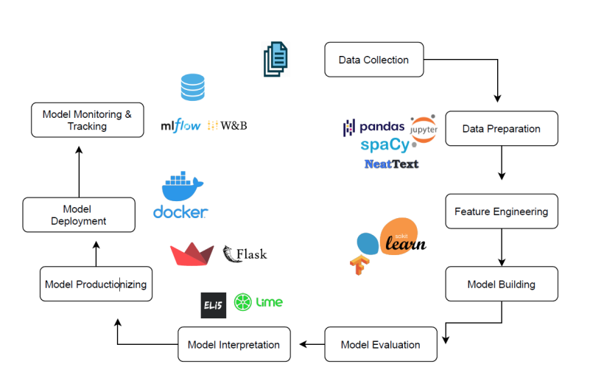
Proposed system

Slide 8
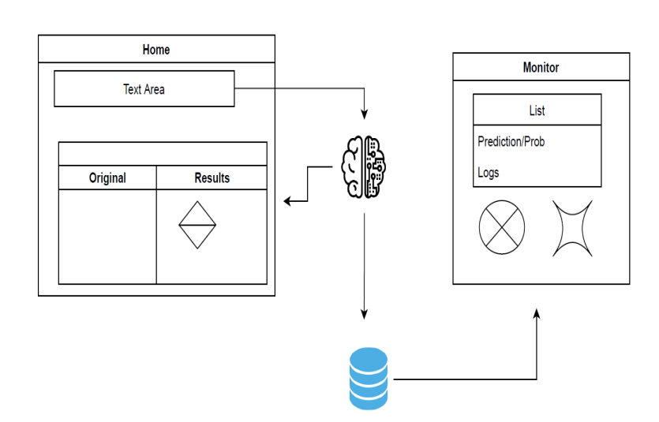
ARCHITECTURE OF SENTIMENT ANALYSIS

Slide 9

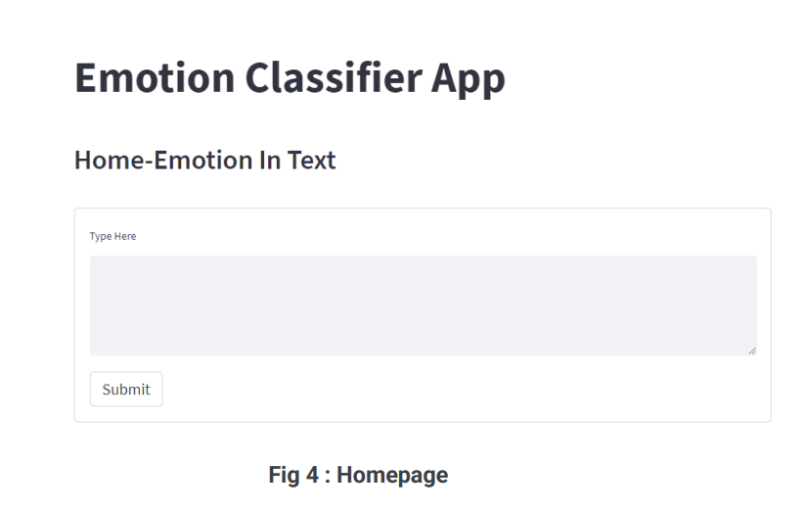
Implementation Screenshots

Slide 10
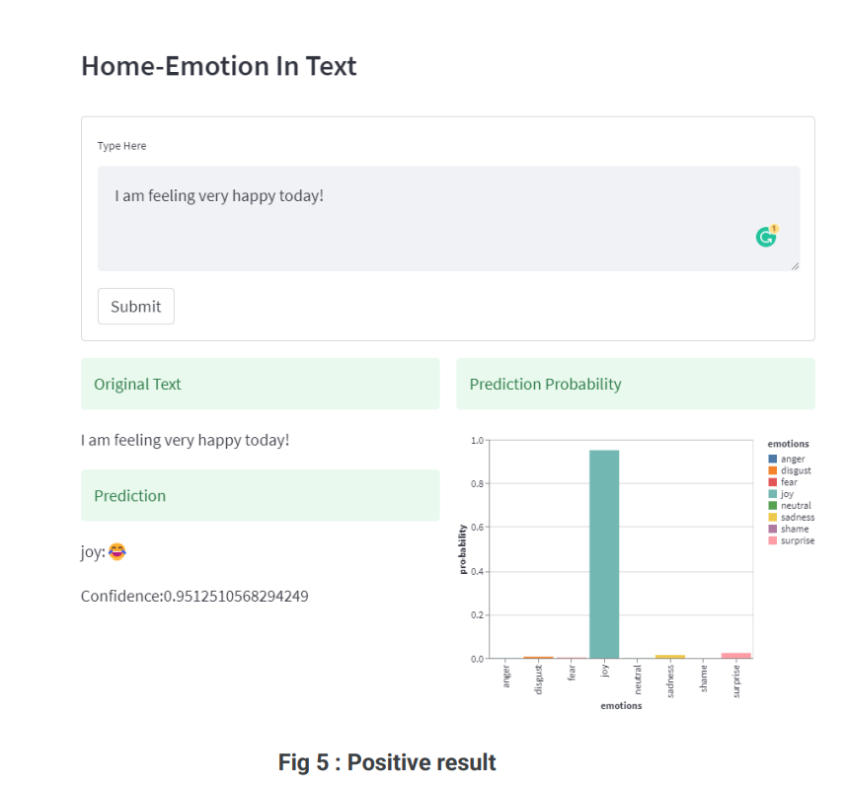

Slide 11
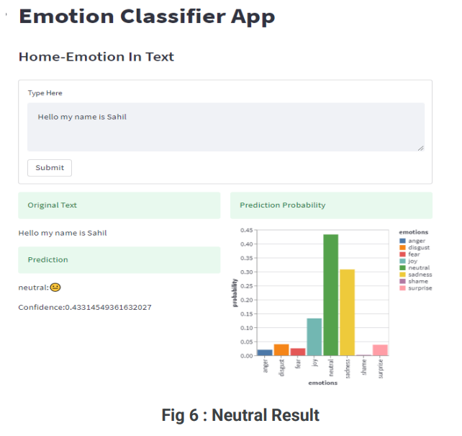
.

Slide 12
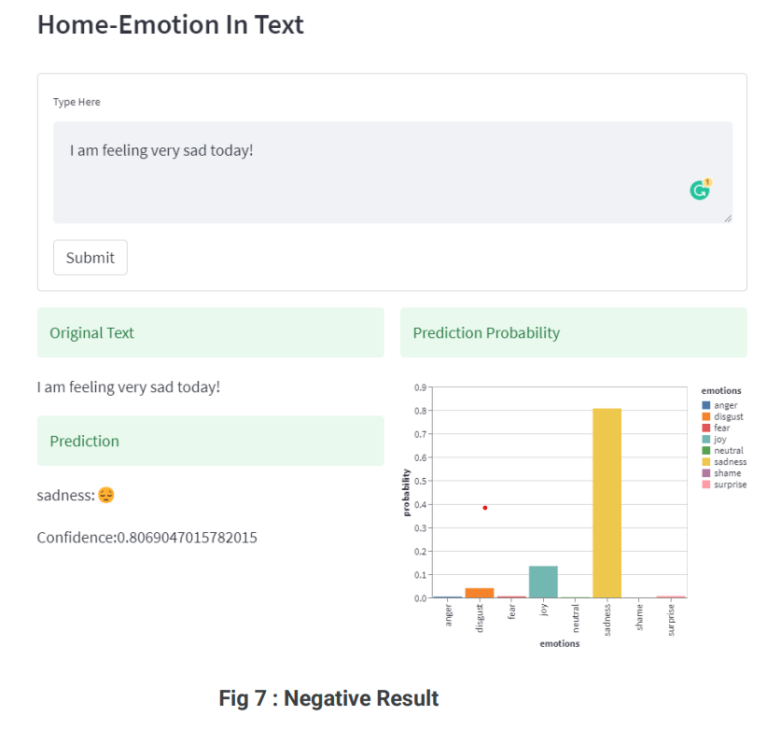
.

Slide 13
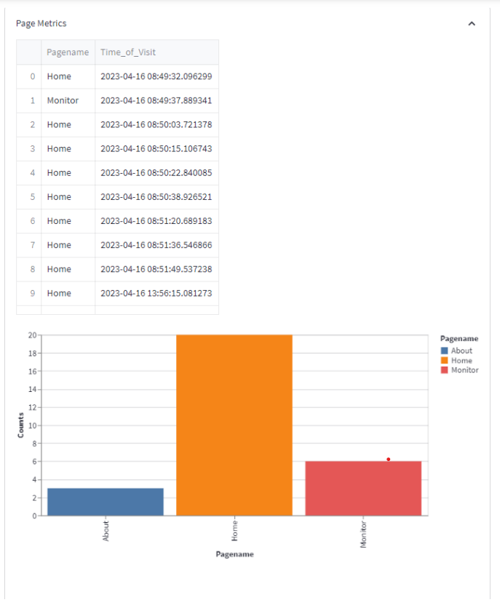
.
.
Fig 8 : Page Metrics

Slide 14
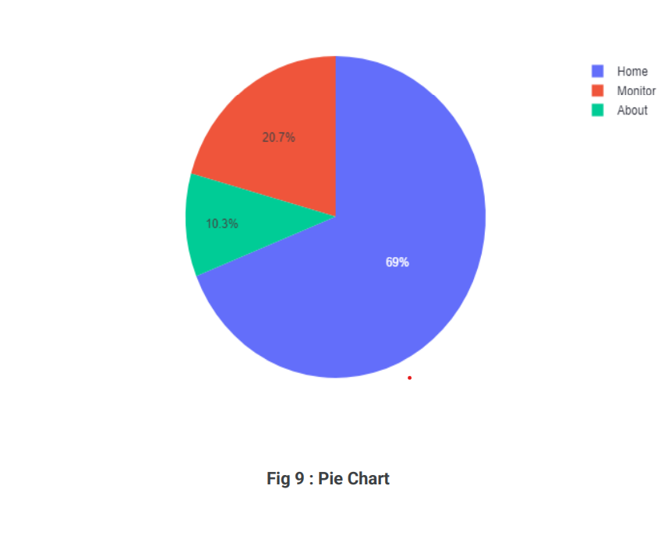
.

Slide 15
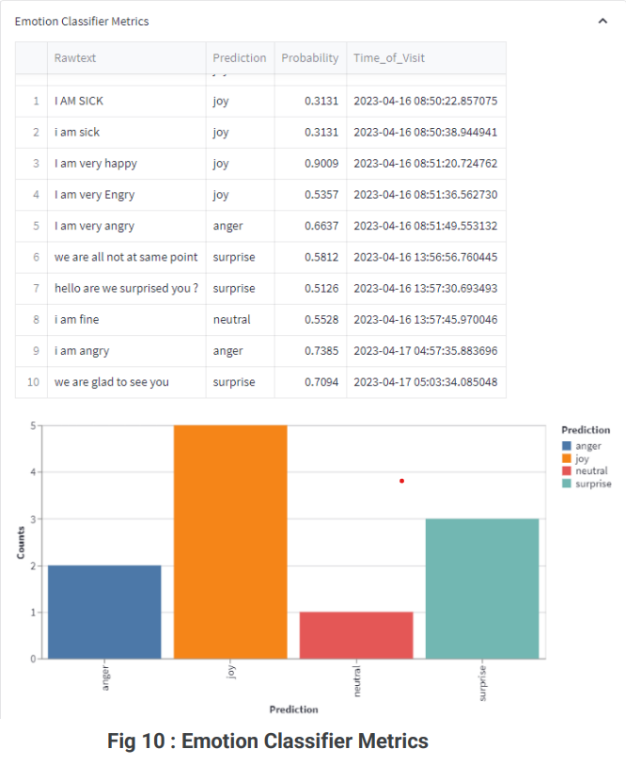
.
.

Slide 16
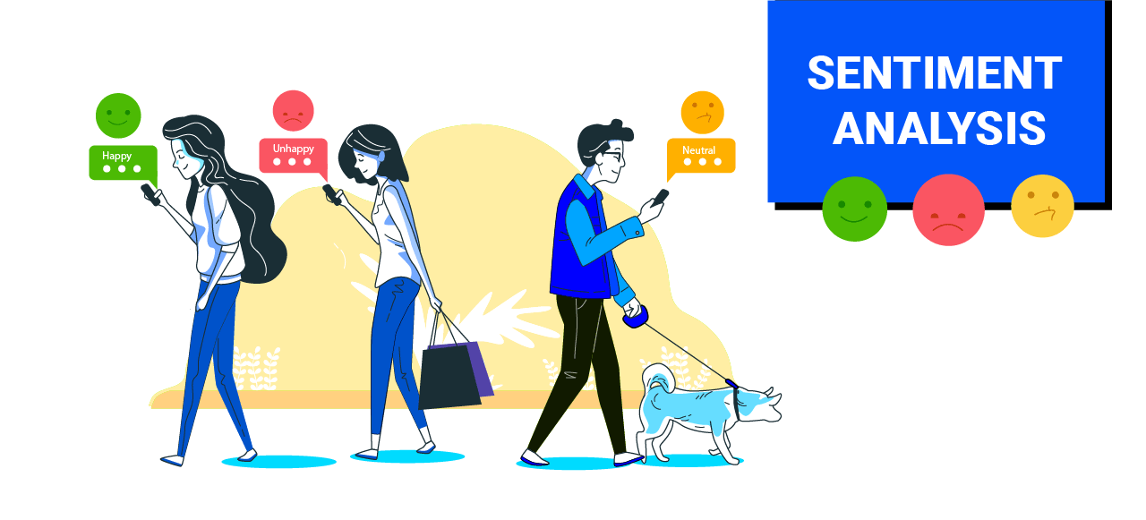
Thank you

